Slide 1
Modeling Visuo-Spatial Sketchpad of Working Memory and Long-Term Memory of Human Brain Through Spiking Neural Networks (SNN)
Amod Holla (4th year BTech student, EE, IIT Delhi)
Co-supervised by:
Prof Sumeet Agarwal (EE, IIT Delhi)
Prof Debanjan Bhowmik (EE, IIT Bombay)

Slide 2
Layout of the Talk
Recap
Improving Retention Time of the Working Memory using a Feedback Path
Circuit Design and Simulation – LIF neuron
Circuit Design and Simulation – Tempotron Synapse
Circuit Design – Crossbar Array for the Overall System
Future Work

Slide 3
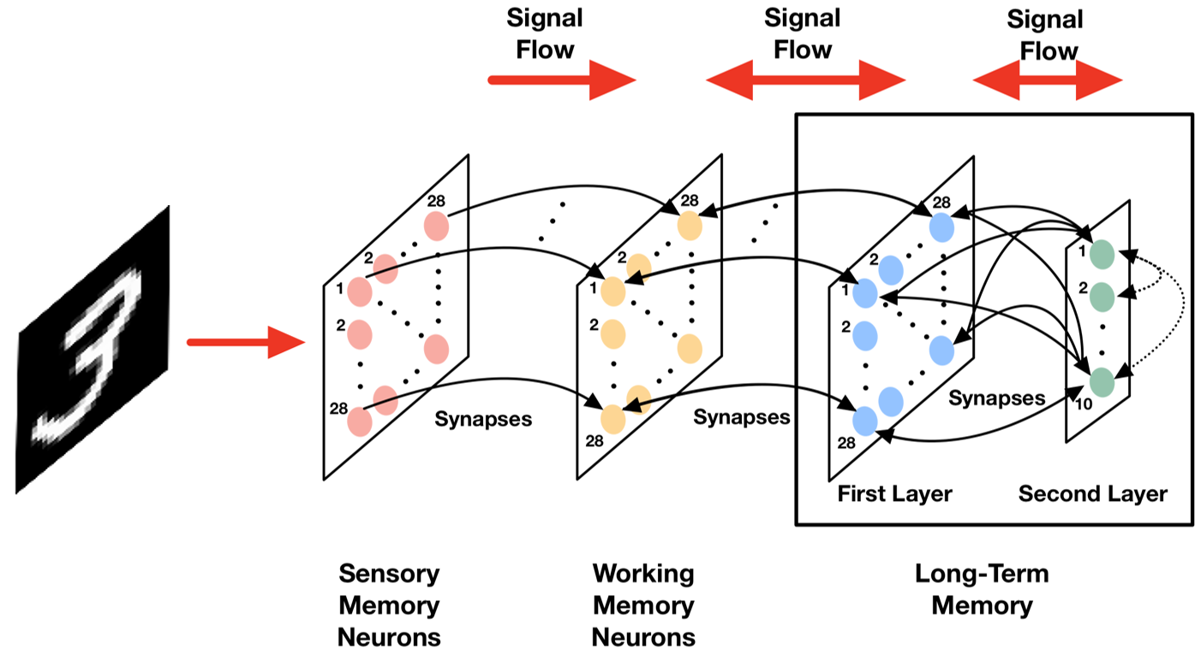
Recap – Visual Memory

Slide 4
Recap – Retention, Recapitulation, Interference
Above visual memory schematic and following experiments were simulated using a high level programming language (Python) and relevant libraries (Brian2)
Retention: Applied image input to the sensory memory neurons, checked retention capability of working memory neurons.
Recapitulation: Activated a second layer neuron of the long-term memory, and observed the firing pattern of working memory neurons
Interference: Applied image input to sensory memory neurons and activated one of the second layer neurons of the long-term memory at the same time, and observed firing patterns of the working memory.

Slide 5
Layout of the Talk
Recap
Improving Retention Time of the Working Memory using a Feedback Path
Circuit Design and Simulation – LIF neuron
Circuit Design and Simulation – Tempotron Synapse
Circuit Design – Crossbar Arrays for the Overall System
Future Work

Slide 6
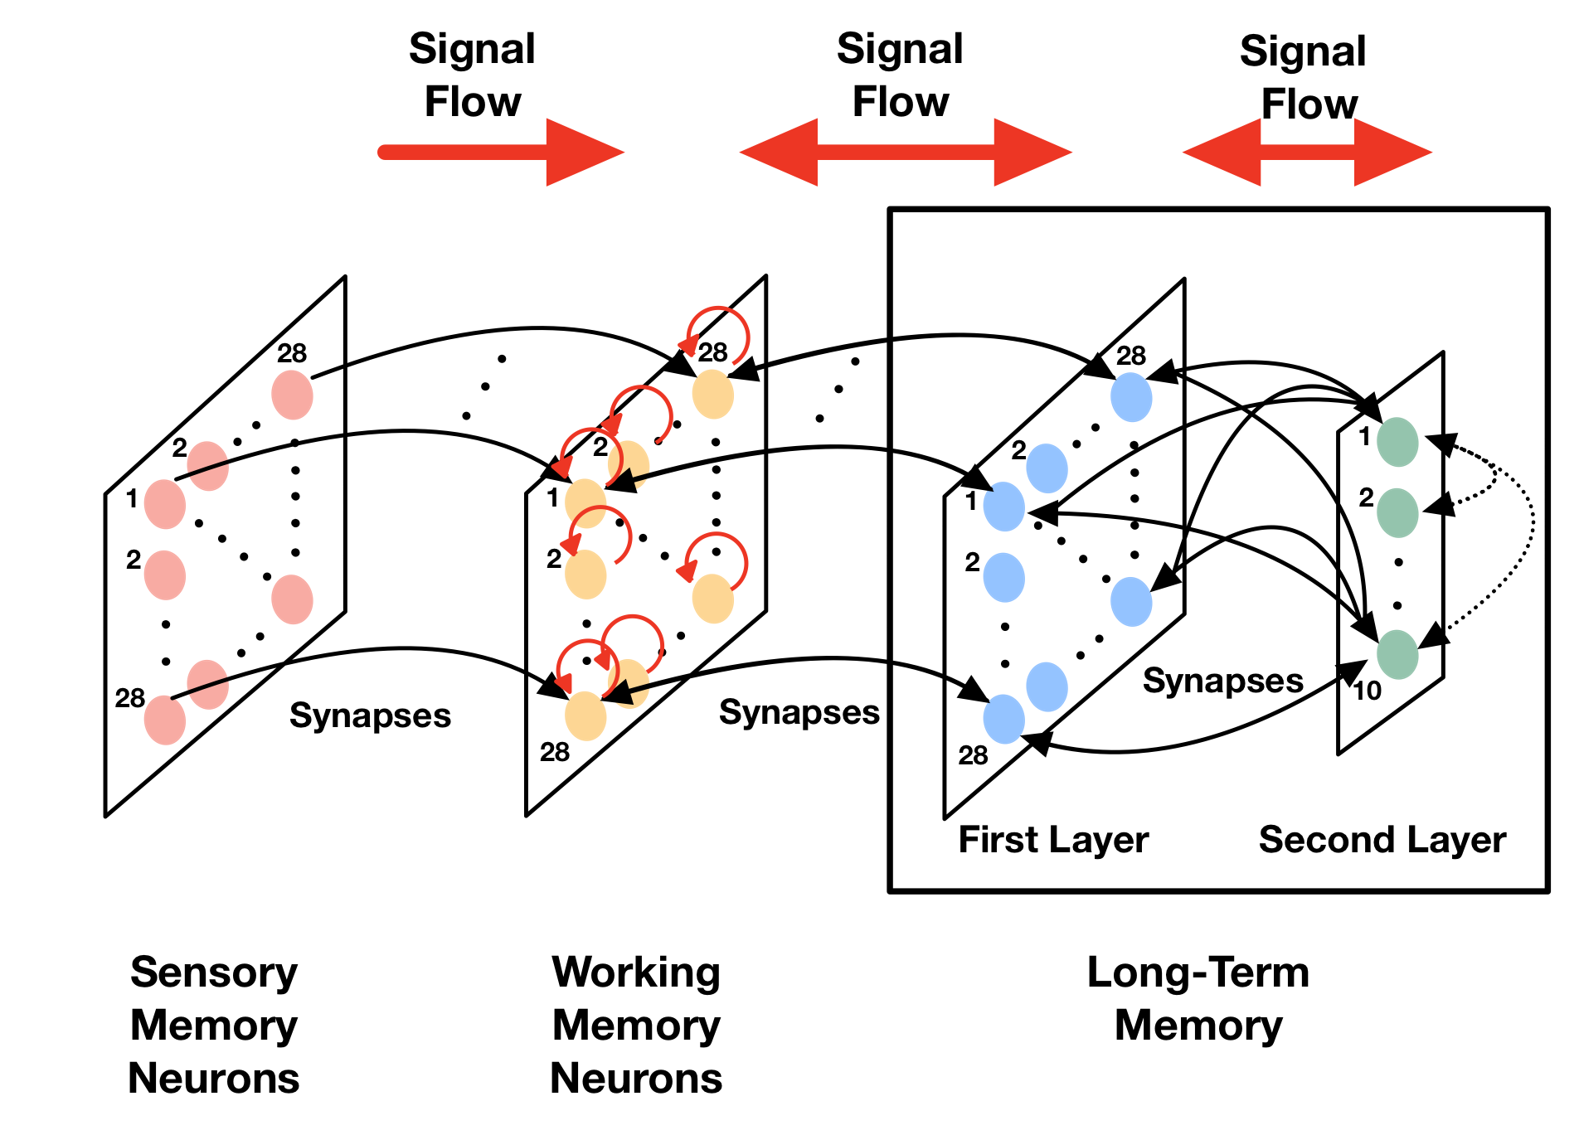
Feedback Path – Working Memory

Slide 7
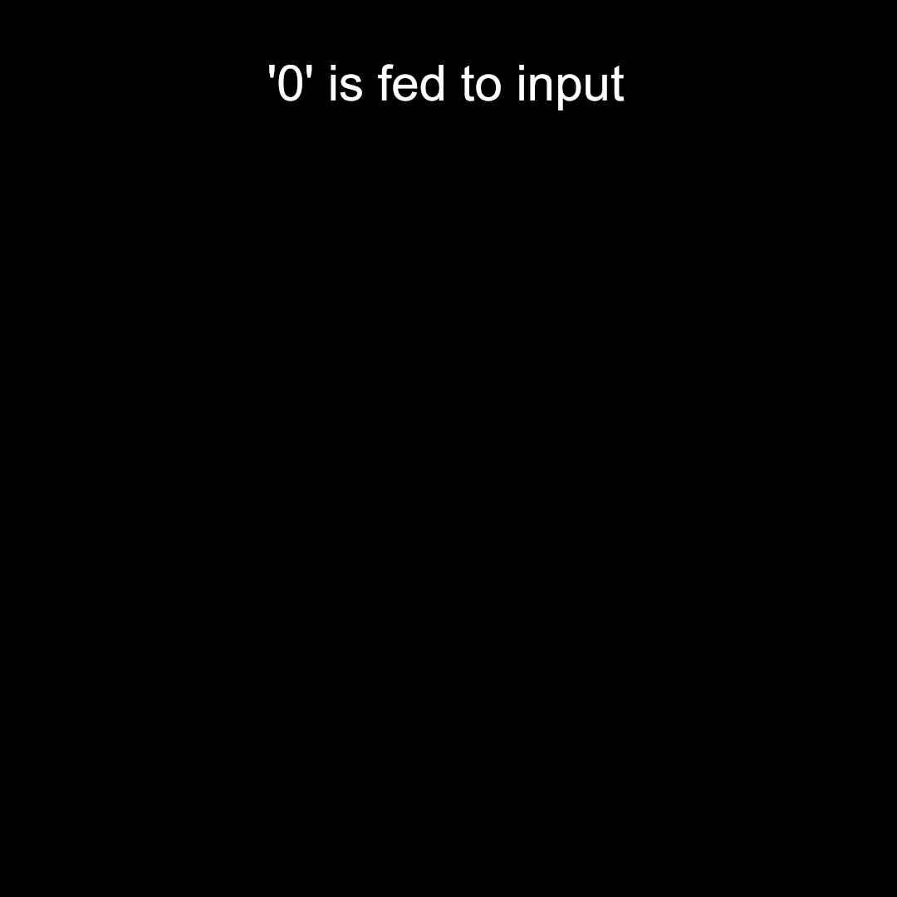
Retention – With Feedback
Apply a single input between t=0 and t=110us. Input is switched off after that. Excitations are viewed in working memory (2 intervals: 0-110us and 110-220us). Note: The stimulus is applied till t = 11s of the video
The video is rescaled from us to s for viewing purposes (1us in reality is 1s in the video)
Retention time is boosted to 110us (from 30us previously) – The retention period is adjustable as well

Slide 8
Layout of the Talk
Recap
Improving Retention Time of the Working Memory using a Feedback Path
Circuit Design and Simulation – LIF neuron
Circuit Design and Simulation – Tempotron Synapse
Circuit Design – Crossbar Arrays for the Overall System
Future Work

Slide 9
Circuit Design - Motivation
Native neuromorphic platform would enable our WM-SNN to process information at biological time scales, in an energy efficient manner.
Possibility for integration with neuromorphic sensor technologies (vision, olfactory, auditory), and make our network multimodal.
Since information is communicated only in the form of spikes/pulses, no need for power hungry A2D, D2A converters that are usually in neuromorphic FCNNs/CNNs.
Anup Vanarse, Adam Osseiran, and Alexander Rassau, Frontiers in Neuroscience, Volume 10 (2016)

Slide 10
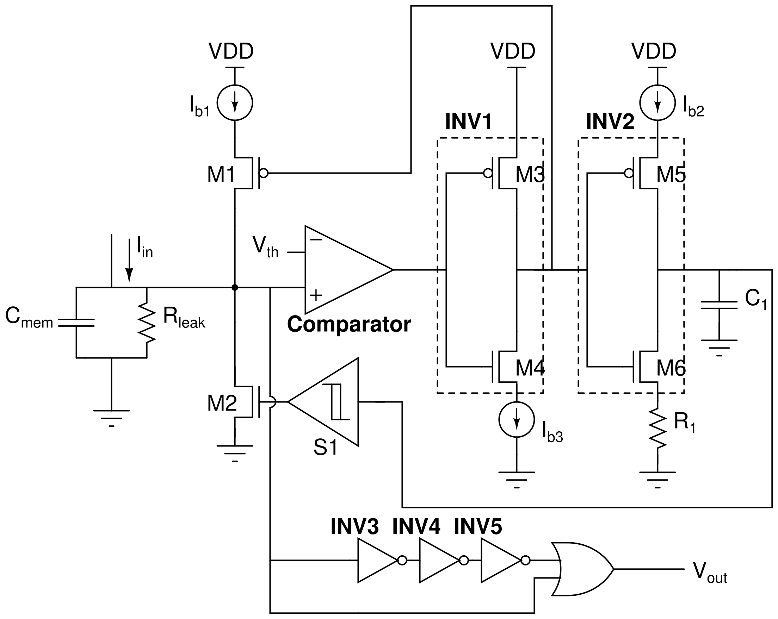
LIF Neuron – Circuit Design
Adjustable pulse width, threshold potential, peak potential, refractory period
Chiara Bartolozzi and Giacomo Indiveri, Neural Computation 19, 10 (2007), 2581–2603.

Slide 11
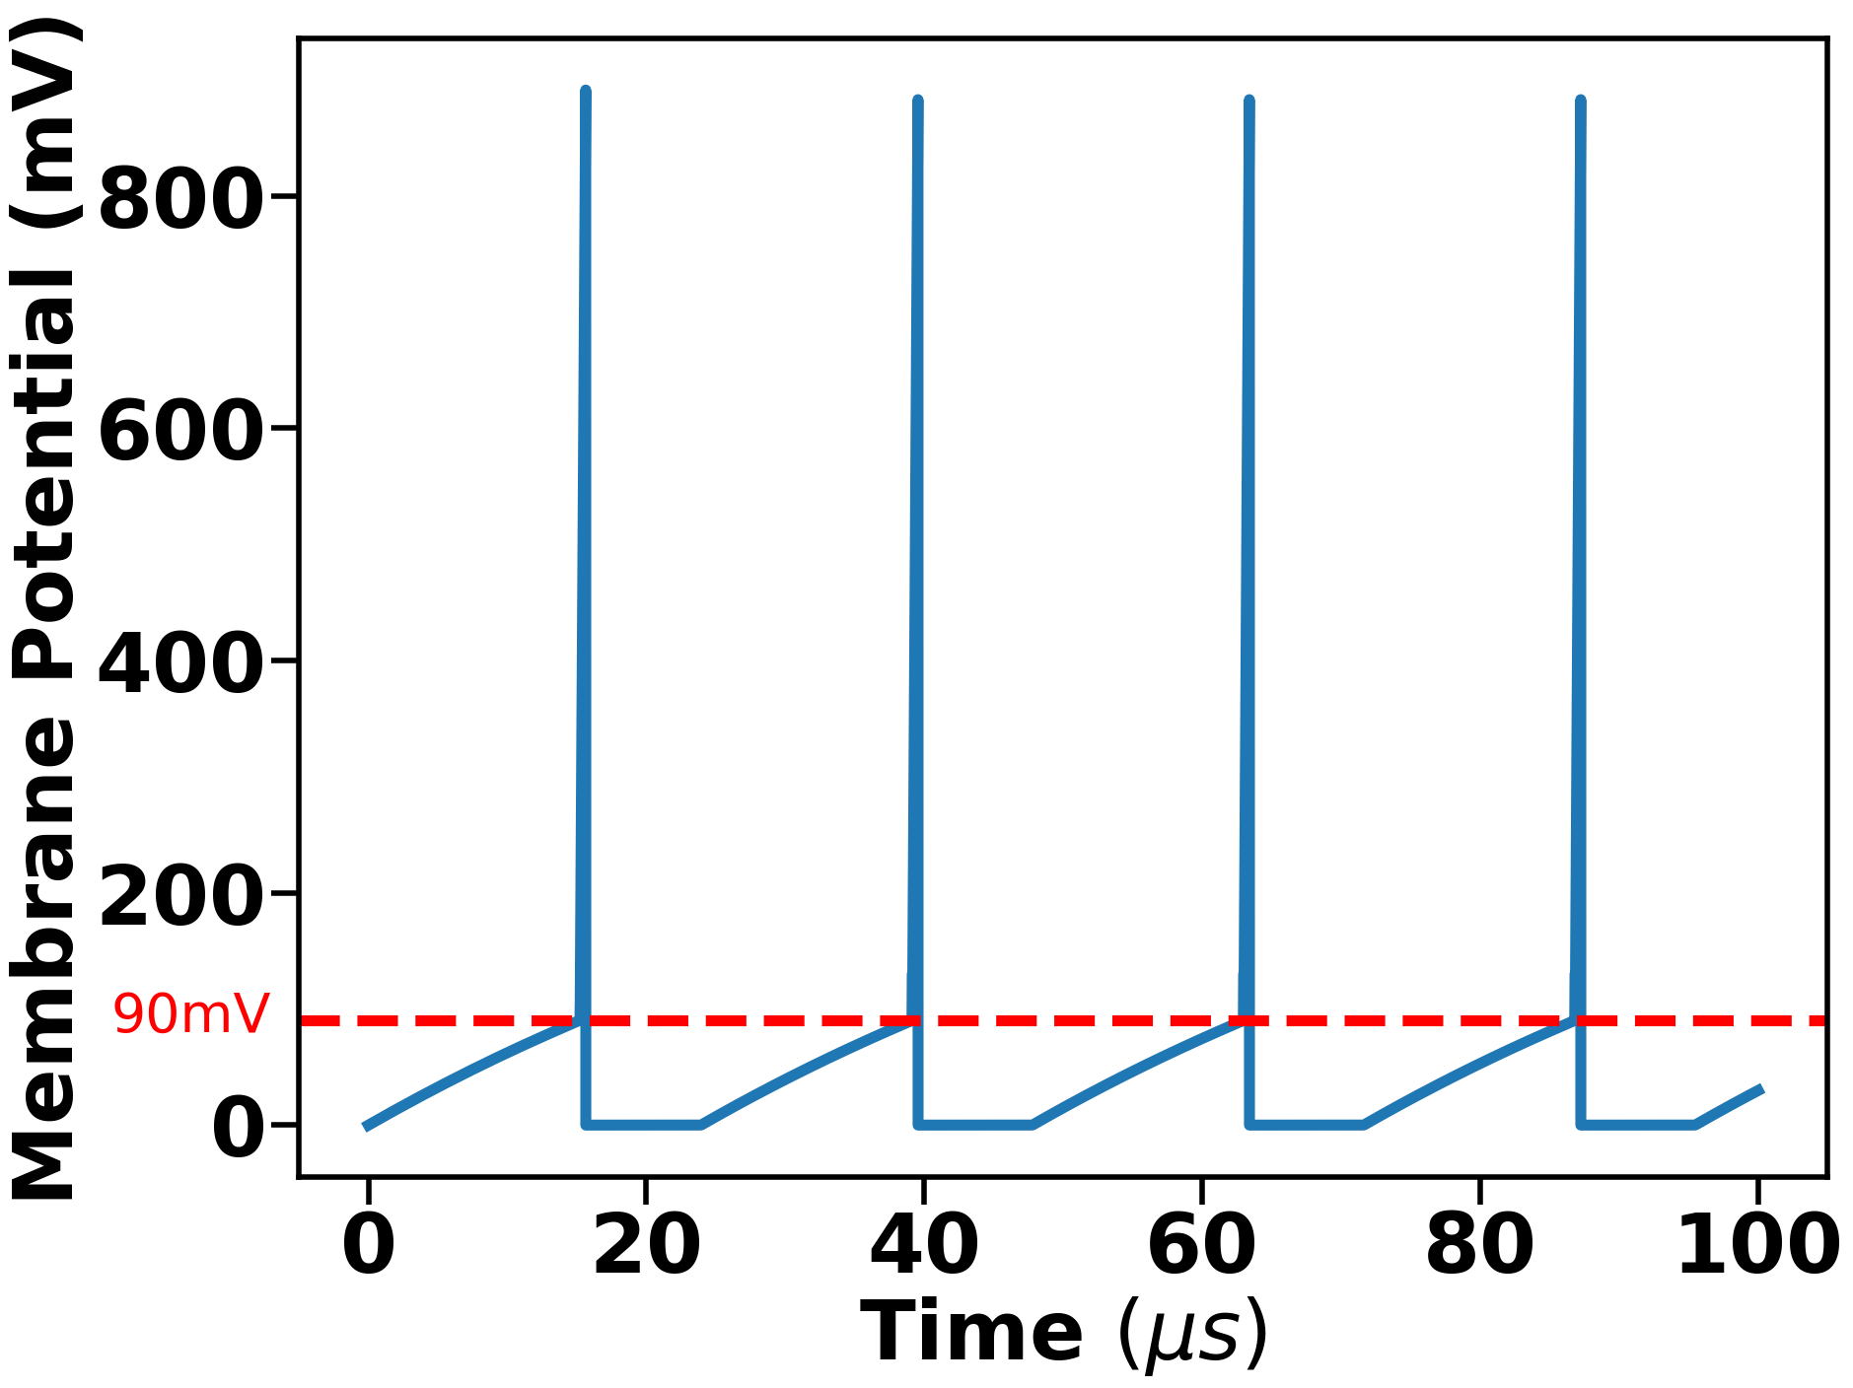
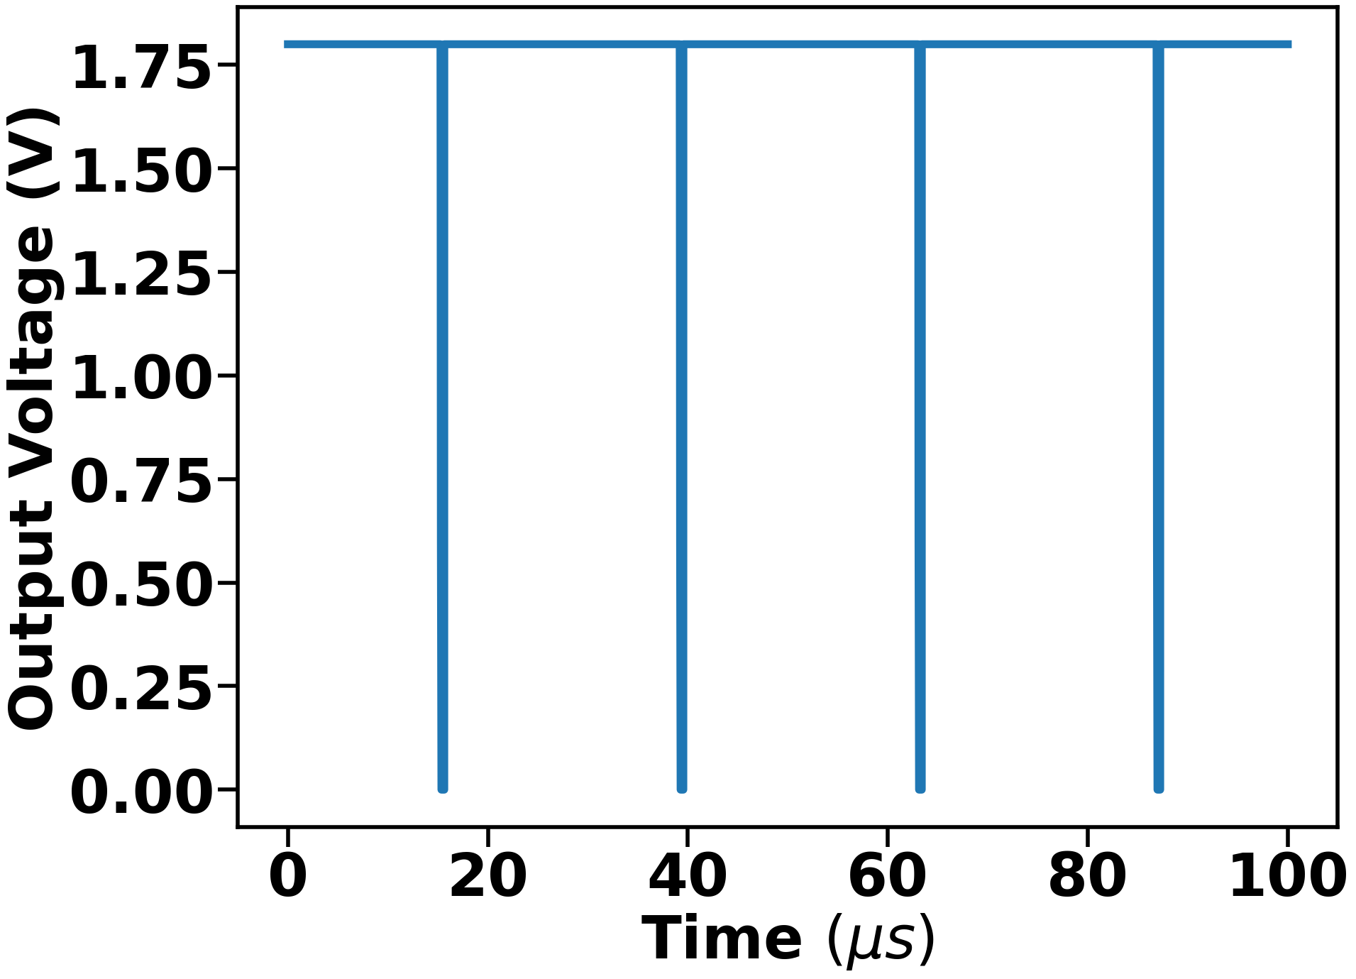
LIF Neuron – Simulation
Input current: 10nA
Threshold Voltage: 90mV
Refractory Period: 8us
Pulse width: 200ns

Slide 12
Layout of the Talk
Recap
Improving Retention Time of the Working Memory using a Feedback Path
Circuit Design and Simulation – LIF neuron
Circuit Design and Simulation – Tempotron Synapse
Circuit Design – Crossbar Arrays for the Overall System
Future Work

Slide 13
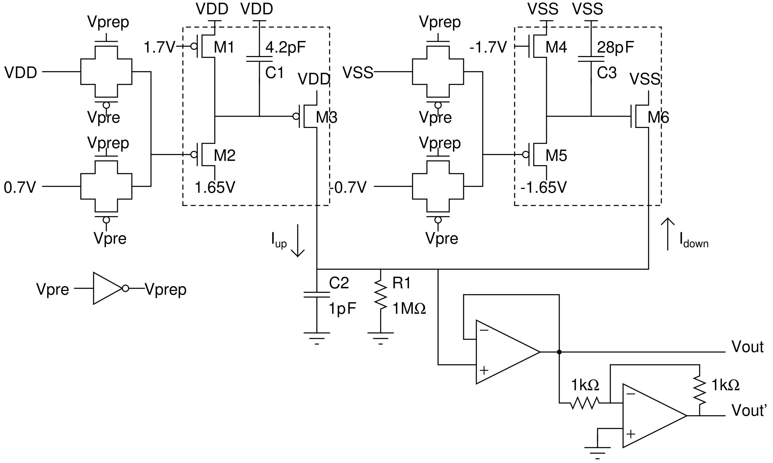
Tempotron Circuit - Design
Chiara Bartolozzi and Giacomo Indiveri, Neural Computation 19, 10 (2007), 2581–2603.

Slide 14
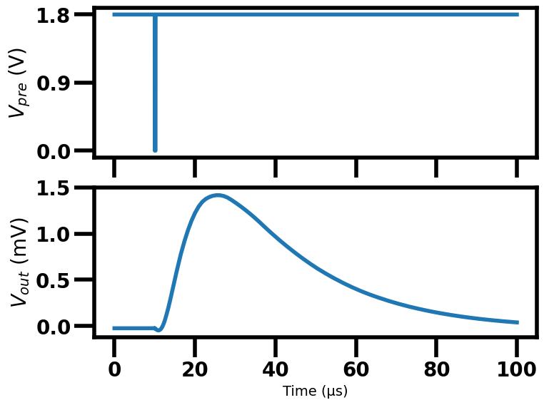
Tempotron Circuit - Simulation
(a)
(b)
𝝉m = 7us
𝝉s = 2.5us

Slide 15
Layout of the Talk
Recap
Improving Retention Time of the Working Memory using a Feedback Path
Circuit Design and Simulation – LIF neuron
Circuit Design and Simulation – Tempotron Synapse
Circuit Design – Crossbar Arrays for the Overall System
Future Work

Slide 16
Overall System Design – Weight to Conductance Mapping
Range of synaptic conductance of a spintronic device: 166S-332S
Range of synaptic weight of our design: 0-900
Linear mapping between the two: w = 900(332g – 1)
Tempotron Current Equation as per our design:
Tempotron Current Equation as per the circuit design:
(Synaptic term + offset)

Slide 17
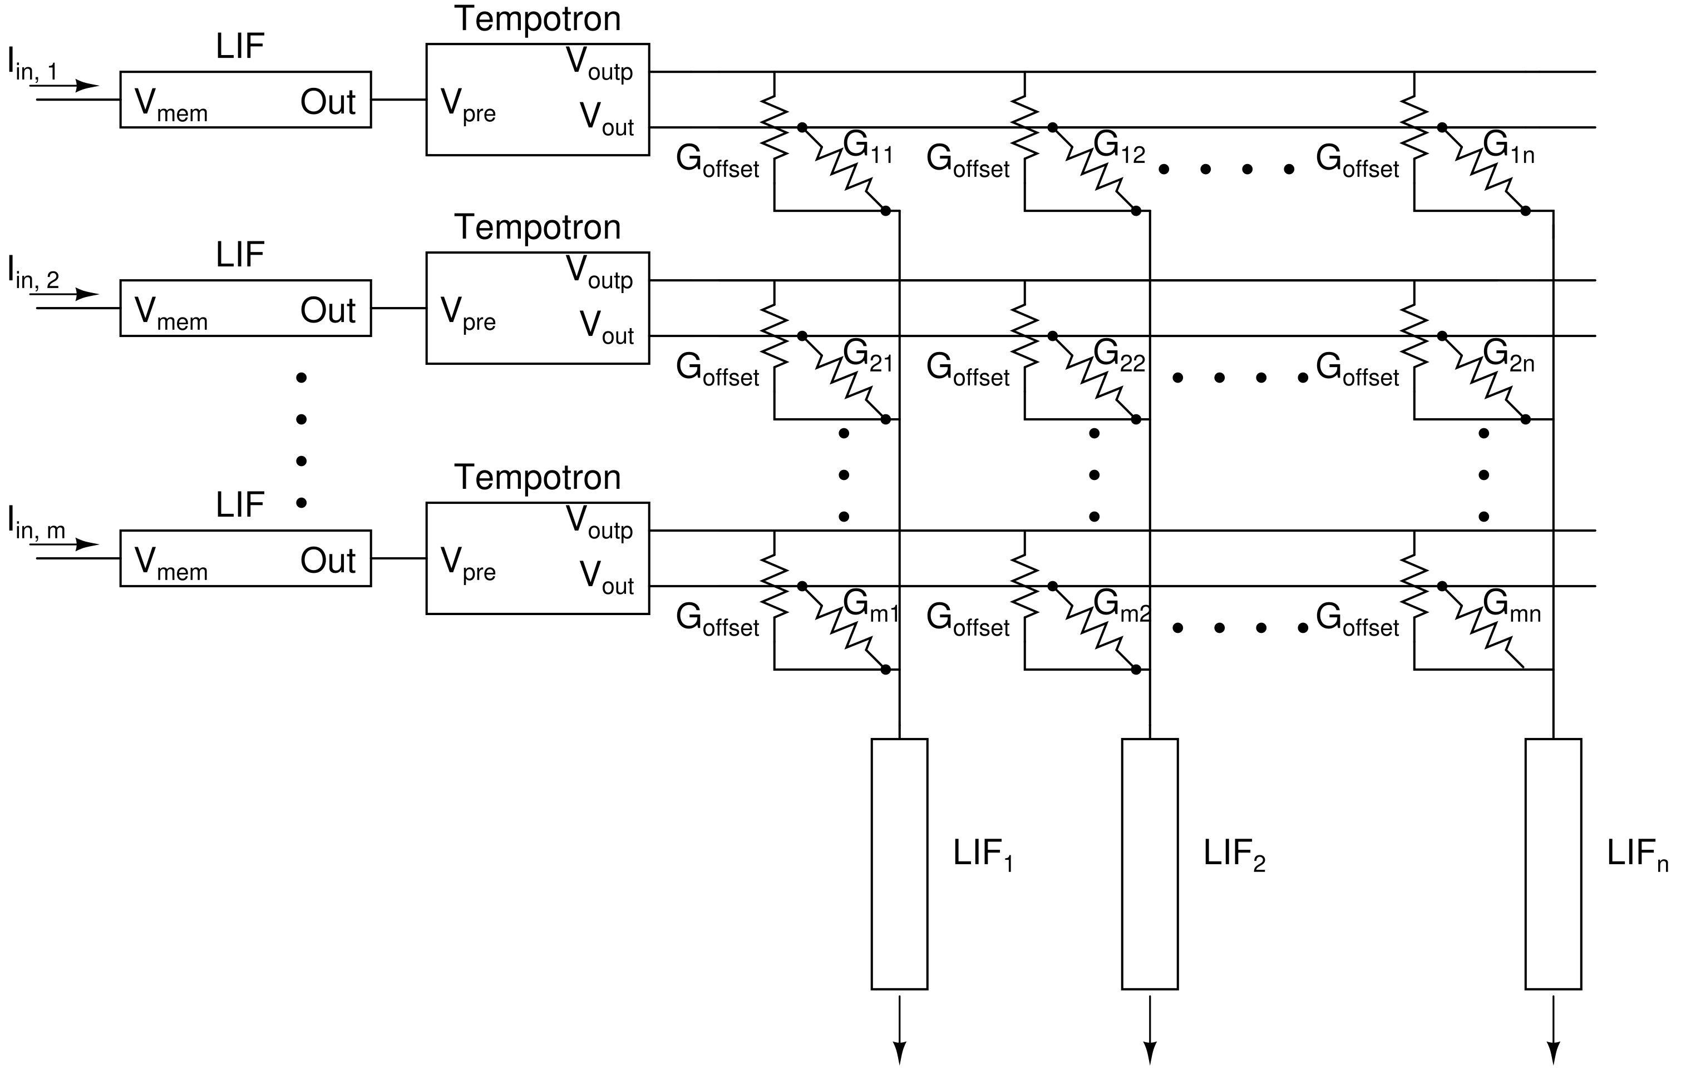
Overall System Design – Fully Connected Nodes

Slide 18
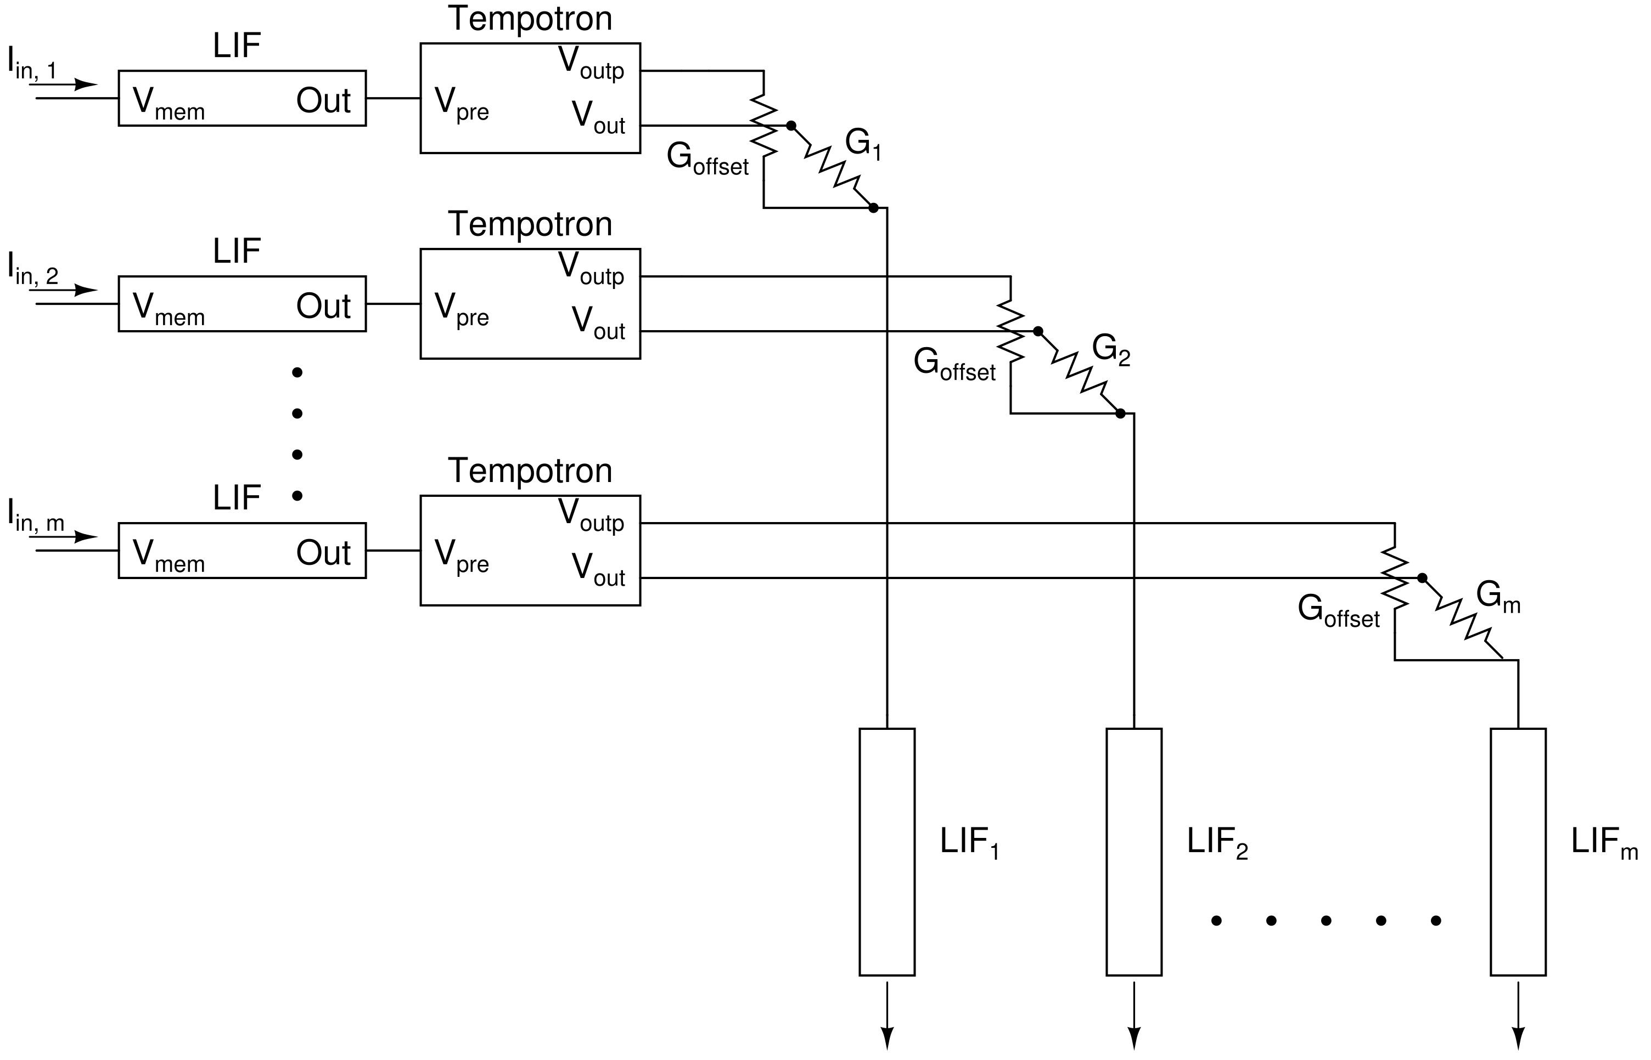
Overall System Design – One to One Nodes

Slide 19
Layout of the Talk
Recap
Improving Retention Time of the Working Memory using a Feedback Path
Circuit Design and Simulation – LIF neuron
Circuit Design and Simulation – Tempotron Synapse
Circuit Design – Crossbar Arrays for the Overall System
Future Work

Slide 20
Summary and Future Work
In this BTP, the entire SNN-WM system was formulated, and the phenomena of retention, recapitulation, and interference were observed on SNNs simulated in Python. In addition, the entire SNN-WM circuit was designed, and the individual constituents and a small 3x3 subset of the crossbar array were simulated using LTSpice.
Future Work
The circuit simulation needs to be expanded to the entire WM-SNN system.
Integration of emerging NVM characteristics (RRAM, PCM, spintronics) in the form of VerilogA models in the simulation.
Implementation of STDP in the existing crossbar array.
Recreation of the retention, recapitulation, and interference experiments on the circuit model.

